Slide 1
Outline
Texture Synthesis by Non-parametric Sampling
Image Quilting for Texture Synthesis & Transfer

Slide 2
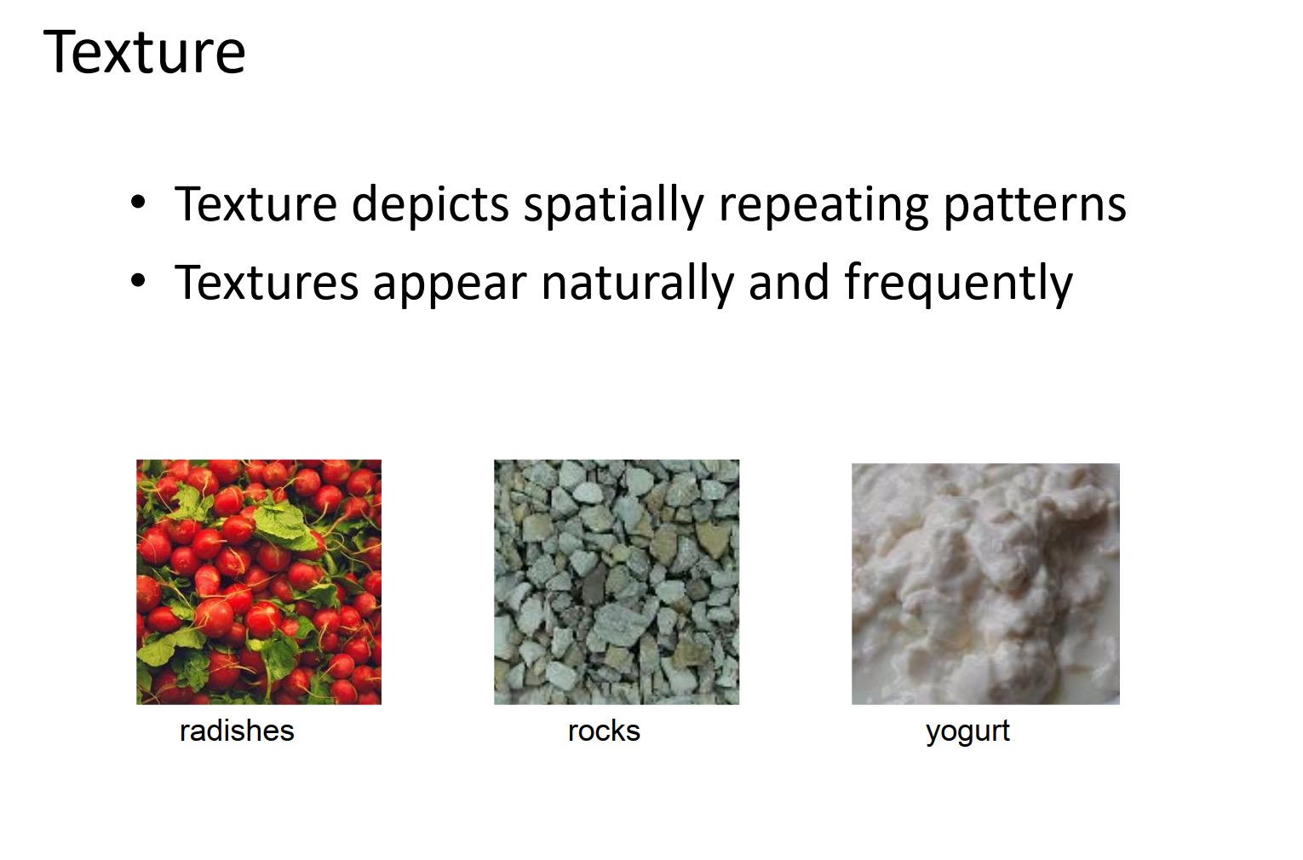

Slide 3
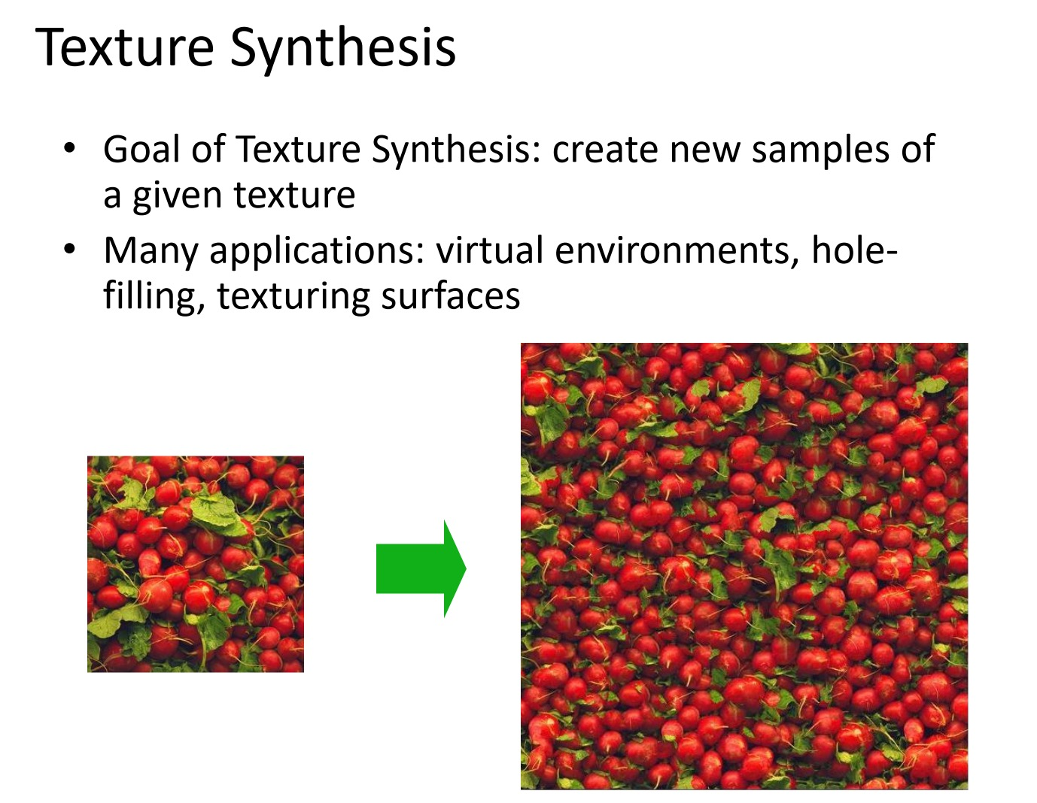

Slide 4
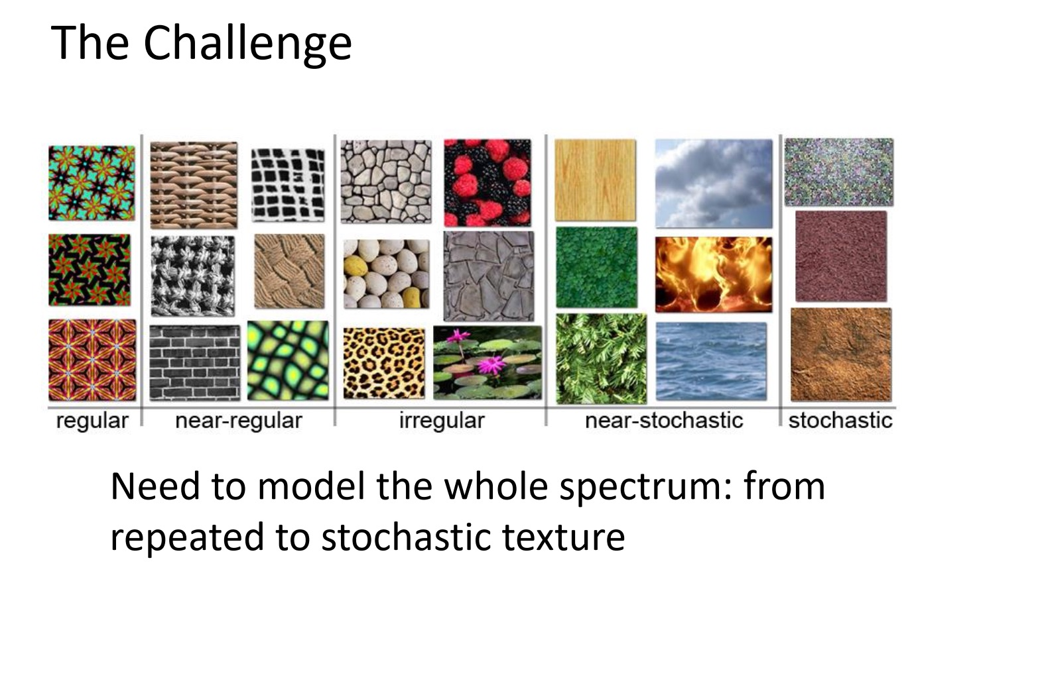

Slide 5
Motivation from Language
[Shannon,’48] proposed a way to generate English-looking text using N-grams:
Assume a generalized Markov model
Use a large text to compute probability distributions of each letter given N-1 previous letters
precompute or sample randomly
Starting from a seed repeatedly sample this Markov chain to generate new letters
One can use whole words instead of letters too:
WE NEED
TO
EAT
CAKE

Slide 6
Mark V. Shaney (Bell Labs)
Results (using alt.singles corpus):
“As I've commented before, really relating to someone involves standing next to impossible.”
"One morning I shot an elephant in my arms and kissed him.”
"I spent an interesting evening recently with a grain of salt"
Notice how well local structure is preserved!
Now let’s try this in 2D...

Slide 7
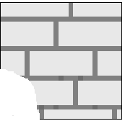

Synthesizing One Pixel
SAMPLE
p
Infinite sample image
Generated image
Assuming Markov property, what is conditional probability distribution of p, given the neighbourhood window?
Instead of constructing a model, let’s directly search the input image for all such neighbourhoods to produce a histogram for p
To synthesize p, just pick one match at random

Slide 8

Really Synthesizing One Pixel
SAMPLE
p
finite sample image
Generated image
However, since our sample image is finite, an exact neighbourhood match might not be present
So we find the best match using SSD error (weighted by a Gaussian to emphasize local structure), and take all samples within some distance from that match

Slide 9

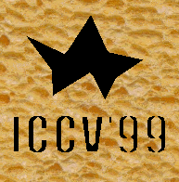
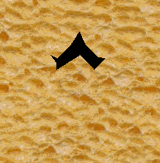
Growing Texture
Starting from the initial configuration, we “grow” the texture one pixel at a time
The size of the neighbourhood window is a parameter that specifies how stochastic the user believes this texture to be
To grow from scratch, we use a random 3x3 patch from input image as seed

Slide 10
Some Details
Growing is in “onion skin” order
Within each “layer”, pixels with most neighbors are synthesized first
If no close match can be found, the pixel is not synthesized until the end
Using Gaussian-weighted SSD is very important
to make sure the new pixel agrees with its closest neighbors
Approximates reduction to a smaller neighborhood window if data is too sparse

Slide 11

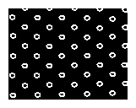
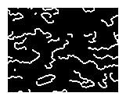
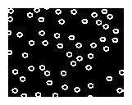
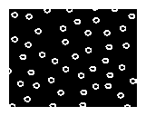
Randomness Parameter

Slide 12

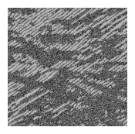
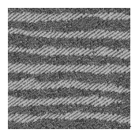
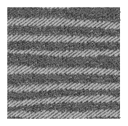
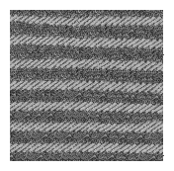

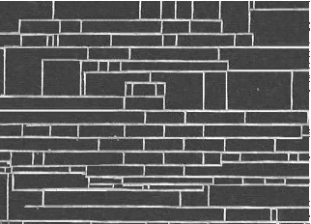
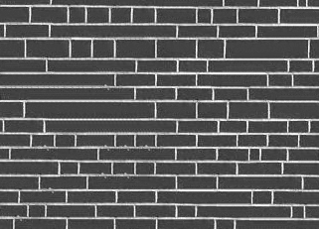
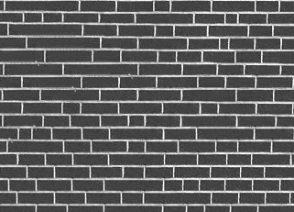
More Synthesis Results
Increasing window size

Slide 13


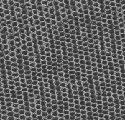
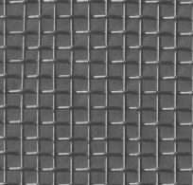
Brodatz Results
reptile skin
aluminum wire

Slide 14


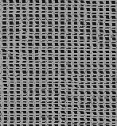
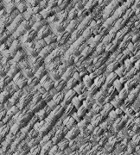
More Brodatz Results
french canvas
rafia weave

Slide 15


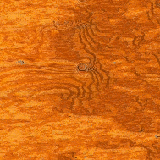
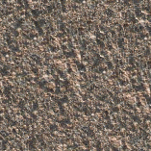
More Results
wood
granite

Slide 16


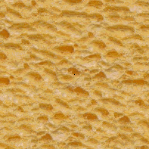
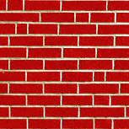
More Results
white bread
brick wall

Slide 17

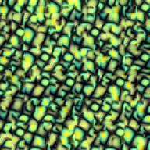
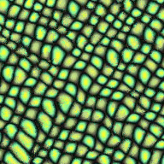
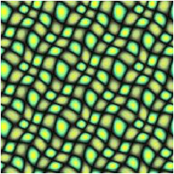
Visual Comparison
Synthetic tilable
texture
[DeBonet, ‘97]
Simple tiling
Our approach

Slide 18
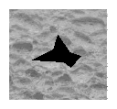
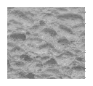
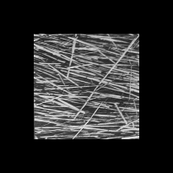
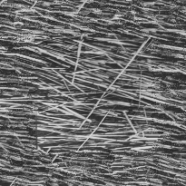
Constrained Synthesis

Slide 19
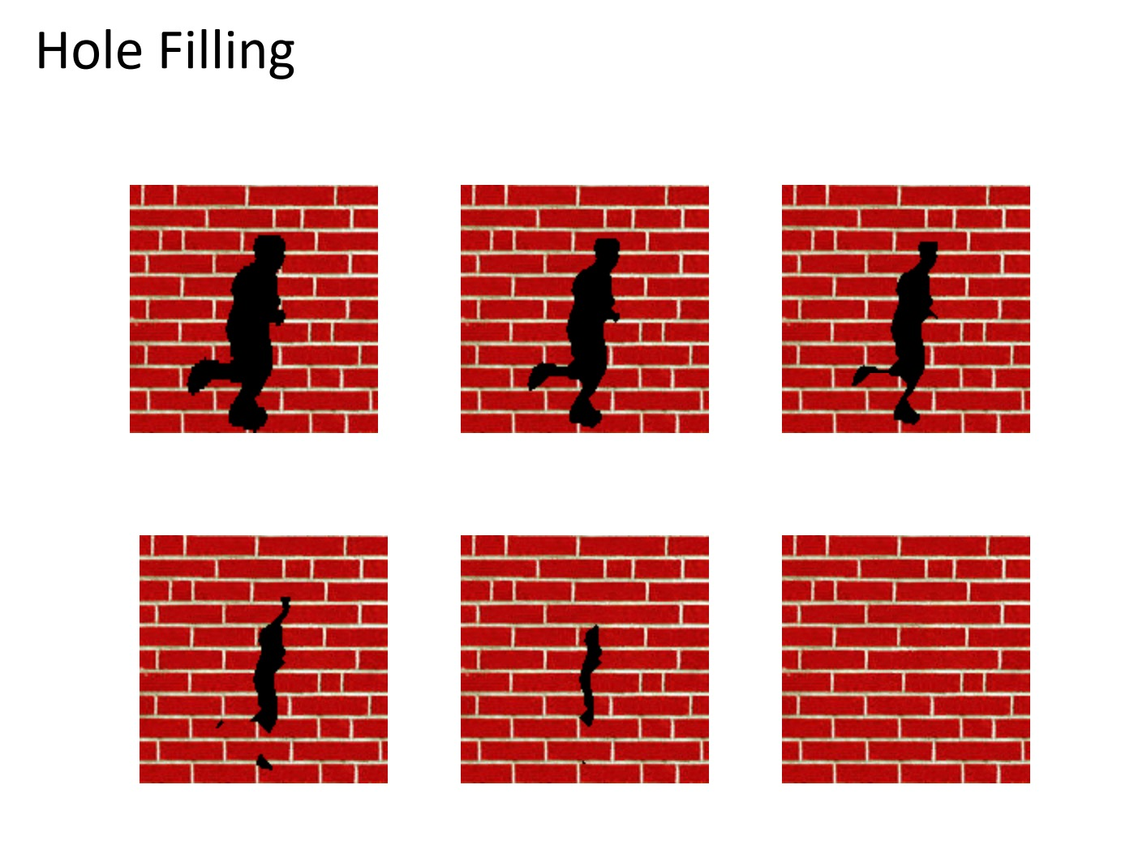

Slide 20
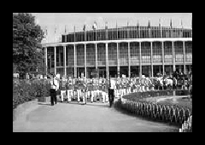
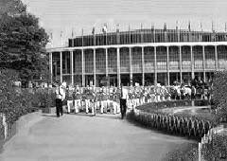
Image Extrapolation

Slide 21
Summary
Advantages:
conceptually simple
models a wide range of real-world textures
naturally does hole-filling
Disadvantages:
it’s greedy
it’s slow
it’s a heuristic
Not an answer to texture analysis, but hopefully some inspiration!

Slide 22
Outline
Texture Synthesis by Non-parametric Sampling
Image Quilting for Texture Synthesis & Transfer

Slide 23
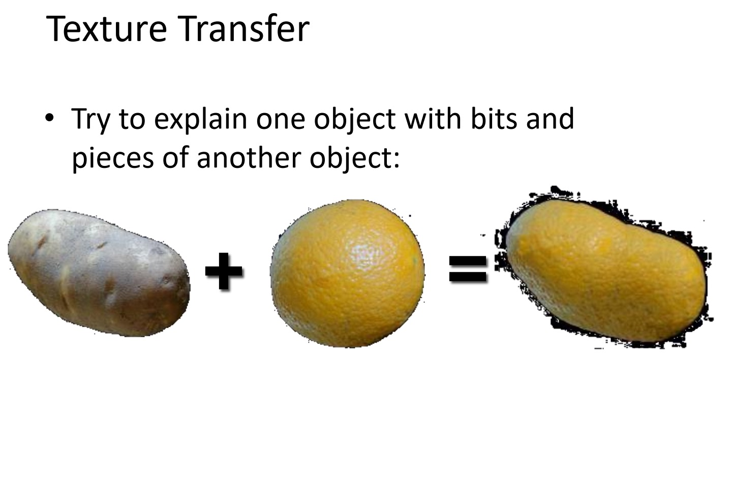

Slide 24

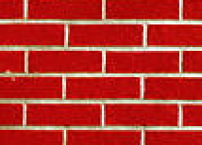
Efros & Leung ’99
non-parametric
sampling
p
Input image
Synthesizing a pixel
Assuming Markov property, compute P(p|N(p))
Building explicit probability tables infeasible
Instead, let’s search the input image for all similar neighborhoods — that’s our histogram for p
To synthesize p, just pick one match at random

Slide 25
Efros & Leung ’99
The algorithm
Very simple
Surprisingly good results
Synthesis is easier than analysis!
…but very slow
Optimizations and Improvements
[Wei & Levoy,’00] (based on [Popat & Picard,’93])
[Harrison,’01]
[Ashikhmin,’01]

Slide 26
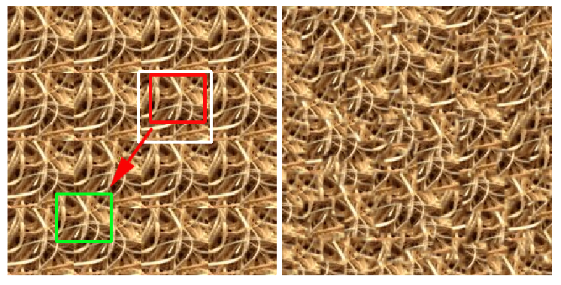
Chaos Mosaic [Xu, Guo & Shum, ‘00]
input
idea
result
Process: 1) tile input image; 2) pick random blocks and place them in random locations 3) Smooth edges
Used in Lapped Textures [Praun et.al,’00]

Slide 27
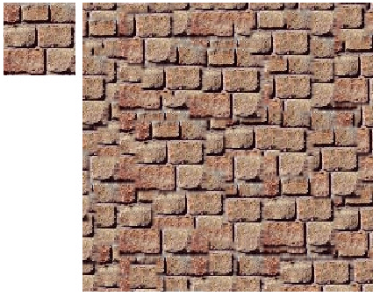
Chaos Mosaic [Xu, Guo & Shum, ‘00]
input
result
Of course, doesn’t work for structured textures

Slide 28
Image Quilting
Idea:
let’s combine random block placement of Chaos Mosaic with spatial constraints of Efros & Leung
Related Work (concurrent):
Real-time patch-based sampling [Liang et.al. ’01]
Image Analogies [Hertzmann et.al. ’01]

Slide 29
Efros & Leung ’99 extended
non-parametric
sampling
p
B
Input image
Synthesizing a block
Observation: neighbor pixels are highly correlated
Idea: unit of synthesis = block
Exactly the same but now we want P(B|N(B))
Much faster: synthesize all pixels in a block at once
Not the same as multi-scale!

Slide 30

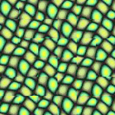
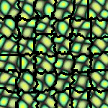
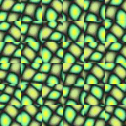
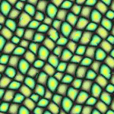
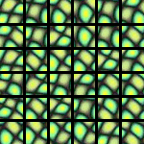
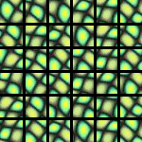
block
Input texture
B1
B2
B1
B2
B1
B2
Random placement
of blocks
Neighboring blocks
constrained by overlap
Minimal error
boundary cut

Slide 31
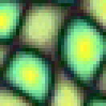
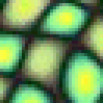
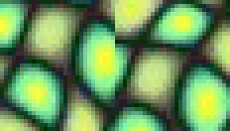


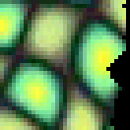
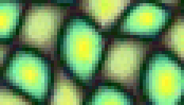

Minimal error boundary
overlapping blocks
vertical boundary
2
_
=
overlap error
min. error boundary

Slide 32
Algorithm
Pick size of block and size of overlap
Synthesize blocks in raster order
Search input texture for block that satisfies overlap constraints (above and left)
Easy to optimize using NN search [Liang et.al., ’01]
Paste new block into resulting texture
use dynamic programming to compute minimal error boundary cut

Slide 33





Slide 34





Slide 36





Slide 37



Slide 38






Slide 39



Slide 40





Portilla & Simoncelli
Xu, Guo & Shum
input image
Wei & Levoy
Image Quilting

Slide 41





Portilla & Simoncelli
Xu, Guo & Shum
input image
Wei & Levoy
Image Quilting

Slide 42


Slide 43


Slide 44


Slide 45
parmesan
+
=
rice
+
=

Slide 46








+
=

Slide 47




+
=

Slide 48


Slide 49

Conclusion
Quilt together patches of input image
randomly (texture synthesis)
constrained (texture transfer)
Image Quilting
No filters, no multi-scale, no one-pixel-at-a-time!
fast and very simple
Results are not bad

